Slide 1



U.S Mortgage Corporation
Data Analytics Project
Uncovering Insights for Mortgage Trends
The primary objective of the U.S. Mortgage Corporation Data Analytics Project is to leverage data-driven insights and analytics to improve operational efficiency, risk management, customer satisfaction, and decision-making within the corporation's mortgage operations
Name : Yogesh Talaskar

Slide 2

Introduction to the Project
1
Purpose and Objectives
Explore the potential of mortgage data analytics to optimize risk assessment, improve customer experience, and enhance operational efficiency.
2
Overview of Mortgage Data Analysis
Understand the role of data analysis in mortgage lending, from loan origination to portfolio management, and the value it brings to the industry.

Slide 3



Data Collection and Preprocessing
1
Sources of Data
Discover the diverse range of data sources, including transactional data, credit data, and property data, used for mortgage analytics.
2
Data Cleaning and Transformation
Learn the crucial steps involved in cleaning and transforming raw mortgage data into a usable format for analysis.
3
Feature Engineering
Explore techniques to extract insightful features from the mortgage dataset, enabling more accurate predictive modeling.

Slide 4


Data Cleaning and Transformation
In this project, we will undertake a comprehensive data analysis process for mortgage data. We'll start by cleaning and preparing the raw data using Excel, ensuring it is accurate and structured for analysis.
Next, we will use SQL to manipulate and transform the data, enabling us to extract valuable insights and derive meaningful patterns.
After the data is refined, we'll leverage Tableau for data visualization, creating interactive and informative dashboards and visualizations to convey our findings effectively.
Additionally, Python will be utilized to perform any advanced data analysis or machine learning tasks as needed.
This project aims to provide a complete end-to-end solution for exploring and understanding mortgage data, from initial data cleaning to insightful visualization and analysis..

Slide 5


Data Cleaning in Excel
Data cleaning ensures reliable and accurate data analysis. It removes errors, inconsistencies, and inaccuracies from the dataset, providing high-quality insights. By eliminating data entry errors, addressing inconsistencies, handling missing data, and detecting outliers, data cleaning enhances data quality and improves decision-making. Ultimately, it leads to better business outcomes.
Key Findings
Industry Implications
Discover actionable insights from the analysis.
Explore the transformative effects on the mortgage industry.

Slide 6

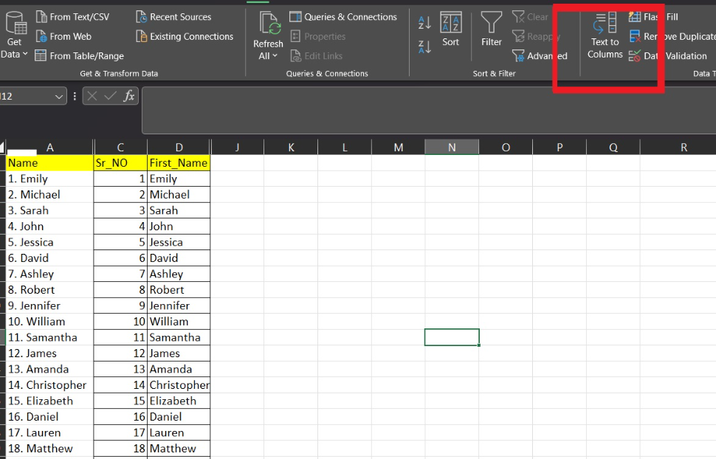
Text to Columns
"Text to columns" is a feature in Excel that separates data from a single column into multiple columns. This can make data easier to read.
Select the cells, locate the "Text to Columns" tool under the "Data" tab, and select the data type from the menu.

Slide 7

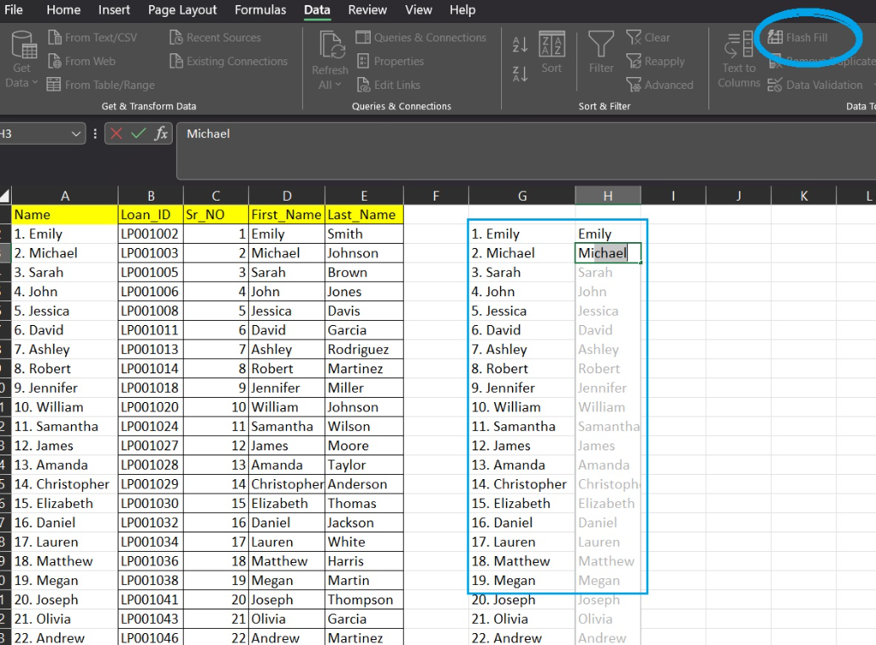
Flash Fill
Flash Fill is a time saver that can make your data look clean and more readable

Slide 8
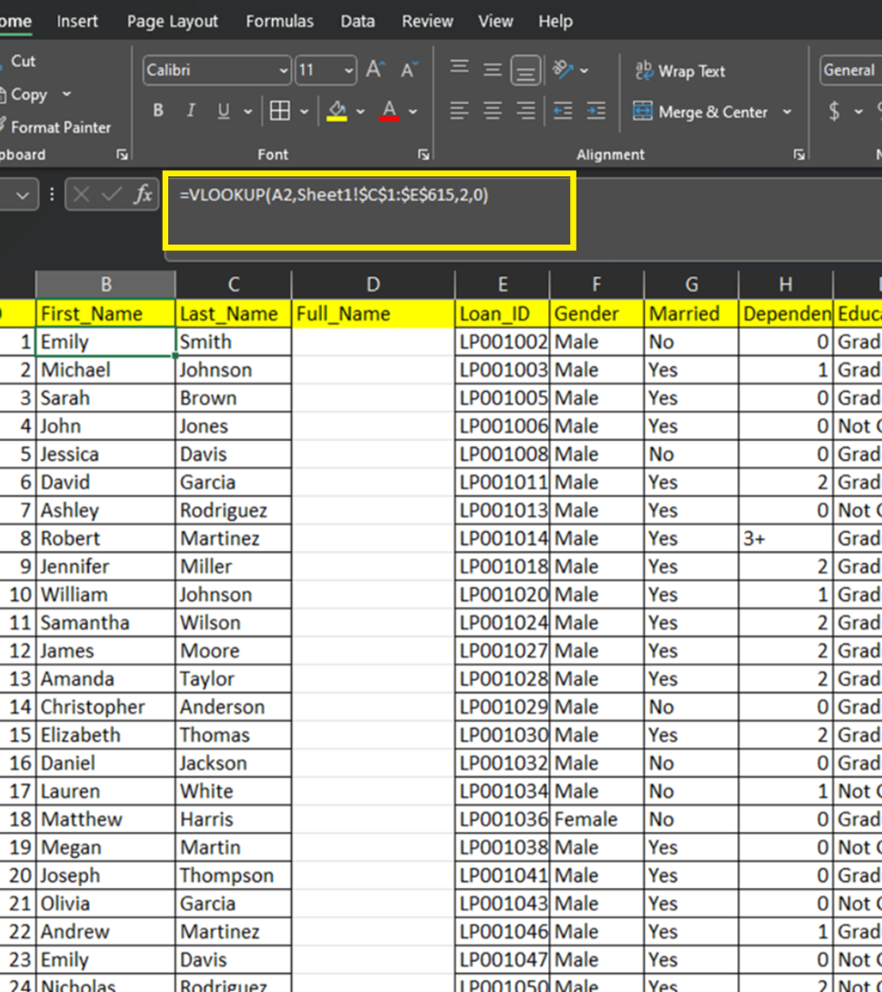
VLOOKUP
Using VLOOKUP fetch the data searches for and retrieves information from a table of data.
Formula: =VLOOKUP(A2,Sheet1!$C$1:$E$615,2,0)

Slide 9
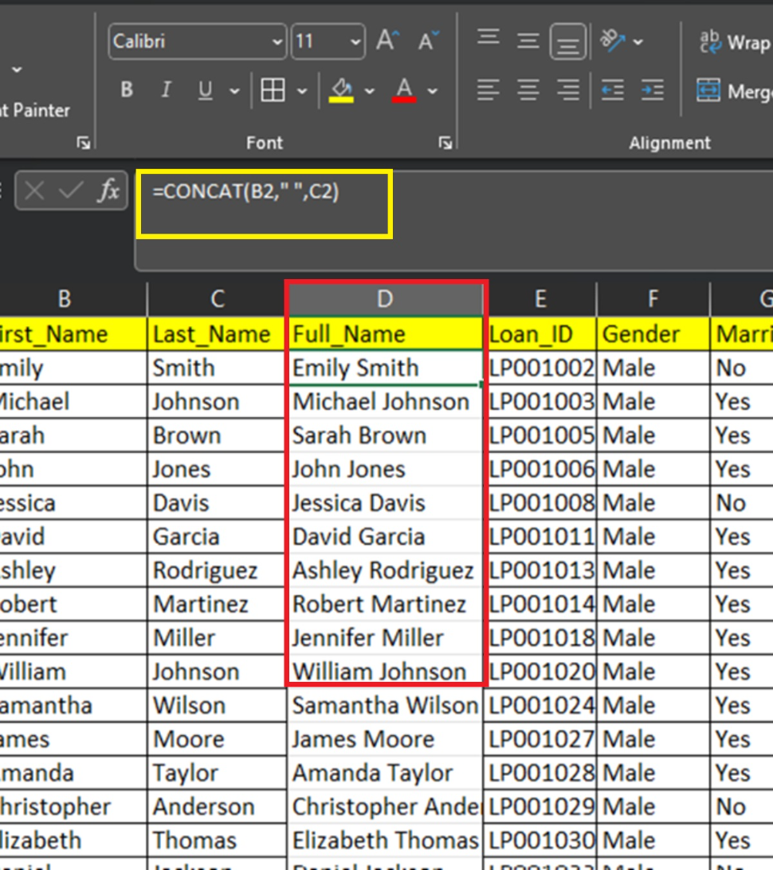
CONCAT
Merge FirstName and LastName to get the Borrower's Fullname using concatenate function.
Formula: =CONCAT(B2," ",C2)

Slide 10

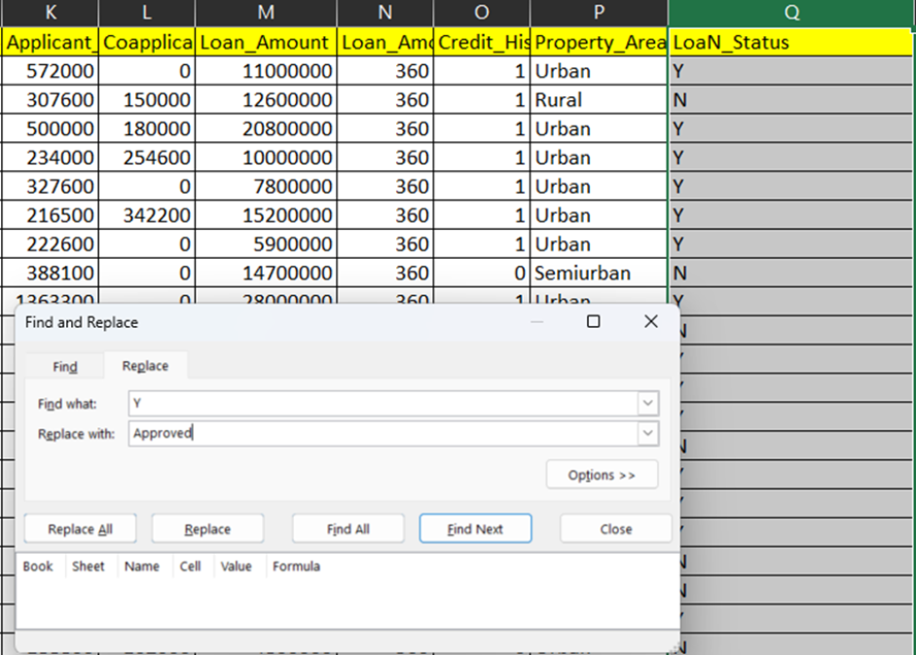
Find & Replace
Find and Replace is a function in Microsoft Excel that allows you to search for and replace text. I used “Y” as “Approved” & “N” as “Under Review”

Slide 11


Mastering SQL Data Cleaning and Transformation
In a U.S. Mortgage Corporation project, SQL is crucial for querying and analyzing large datasets containing borrower information, loan details, and financial metrics, facilitating efficient data extraction and insights generation essential for informed decision-making and risk assessment.

Slide 12
Key Points
Removing Duplicates
Handling Missing Values
Learn how to effectively remove duplicate entries from your data.
Discover techniques to handle missing values in your data.
Standardizing Data Formats
Powerful SQL Functions
Explore methods to standardize data formats for consistency.
Get familiar with powerful SQL functions for data cleaning and transformation.

Slide 13
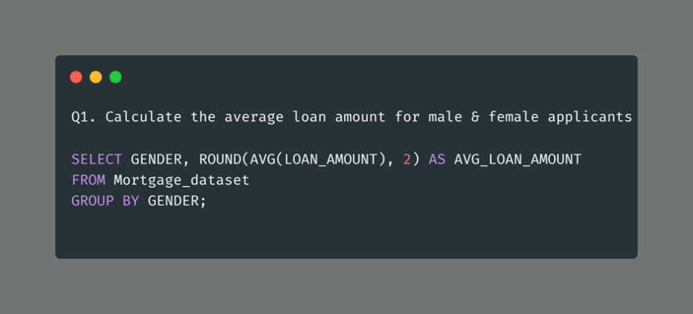
In this SQL query, we extract data from the "Mortgage dataset" and filter it to include only male applicants by "GENDER". We then calculate the average loan amount for this specific group of male & female applicants. The result, labeled as "AVG_LOAN_AMOUNT," represents the mean loan amount borrowed by male & female applicants.

Slide 14
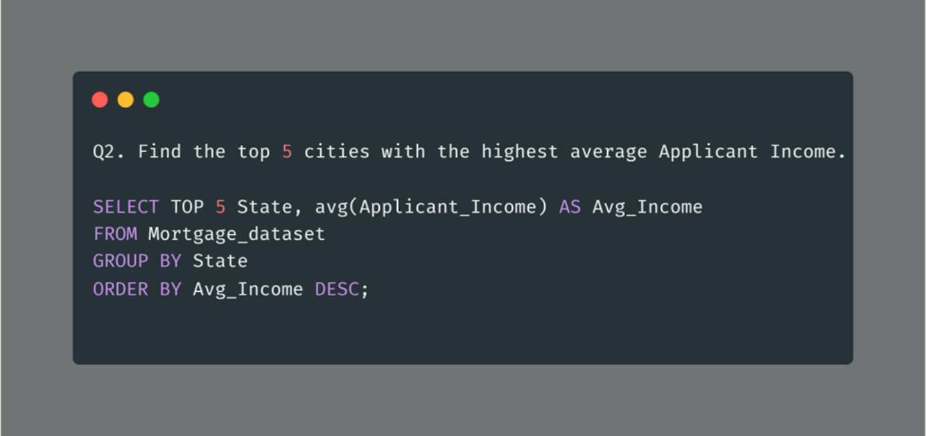
we have extracted valuable insights by identifying the top 5 cities with the highest average applicant income. This analysis is a key part of understanding the economic landscape and income distribution among mortgage applicants.

Slide 15
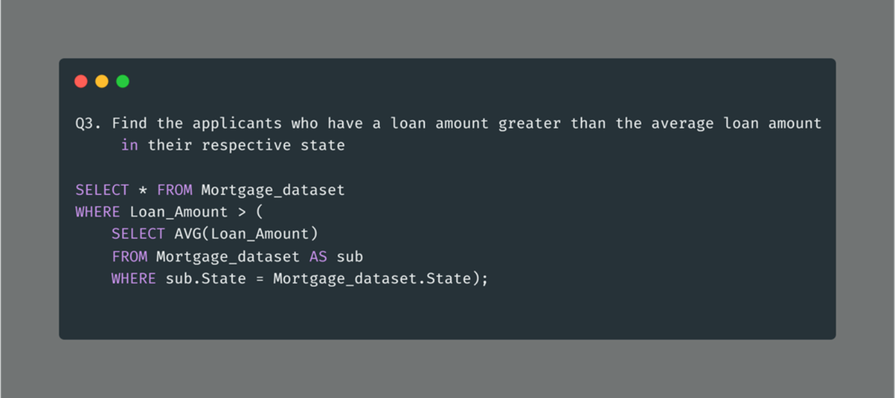
In this SQL query, we are aiming to identify applicants who have taken out a loan amount greater than the average loan amount for their respective states. This analysis can uncover whether applicants in specific states tend to take out loans above or below the state average.

Slide 16
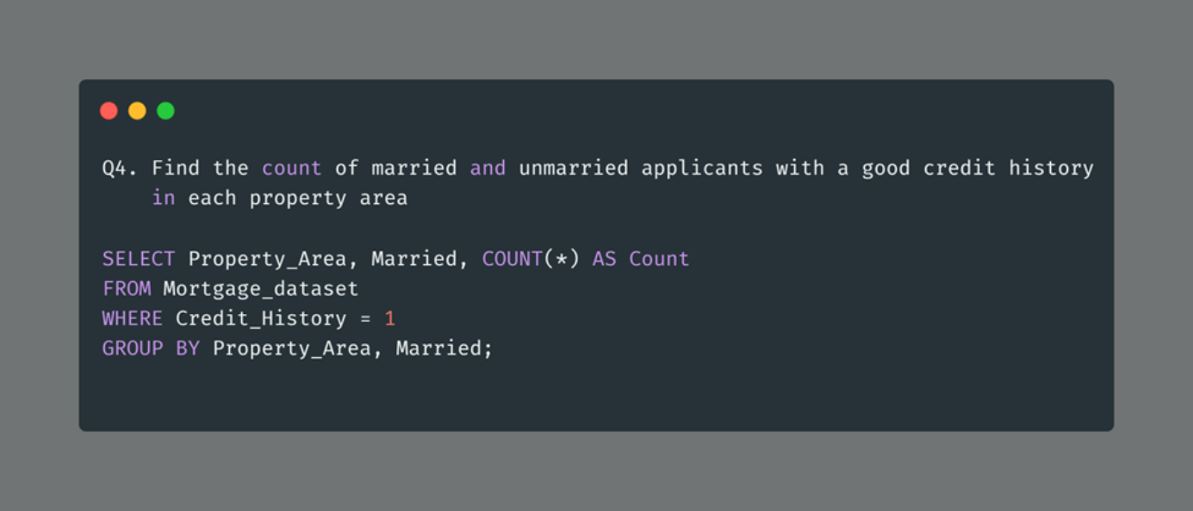
it's essential to understand the distribution of applicants based on their marital status and credit history, segmented by property areas. This query provides valuable insights into how many applicants with good credit history are married and unmarried within each property area.

Slide 17
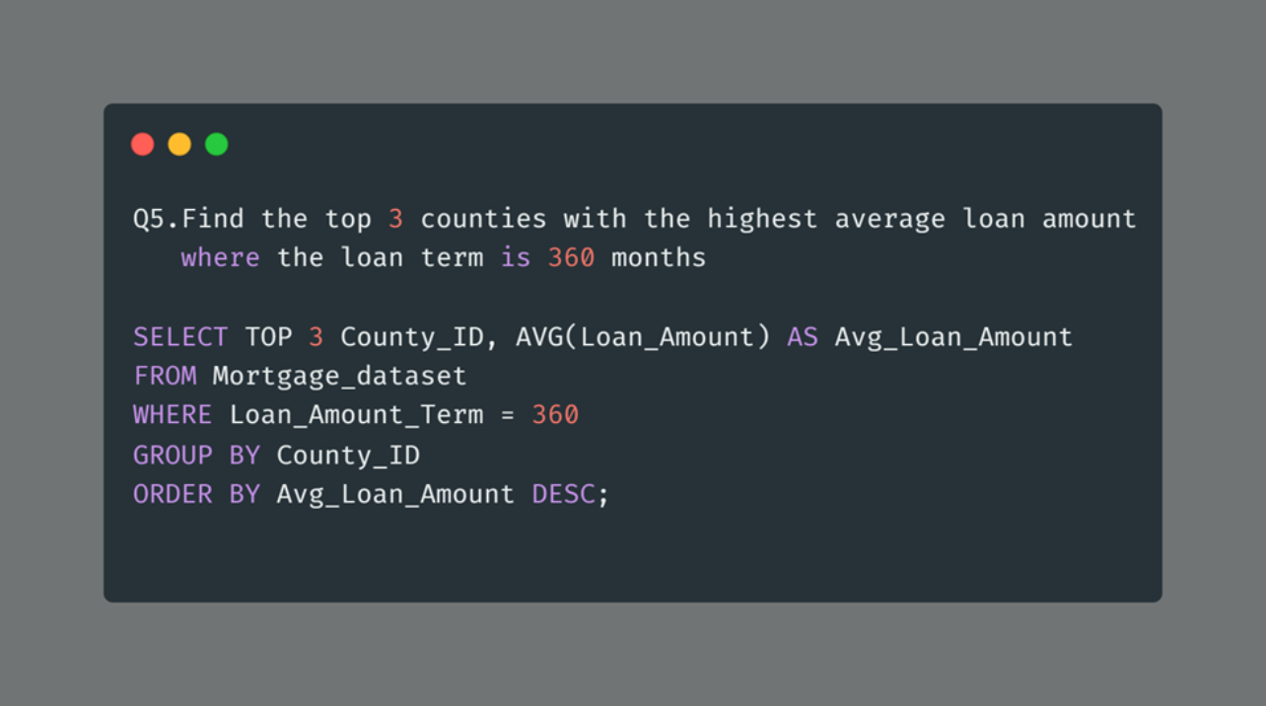
Identifying the counties where borrowers are securing the highest average loan amounts for 30-year mortgage terms. The SQL query efficiently accomplishes this by filtering the dataset for loans with a 360-month term and then grouping the data by county

Slide 18
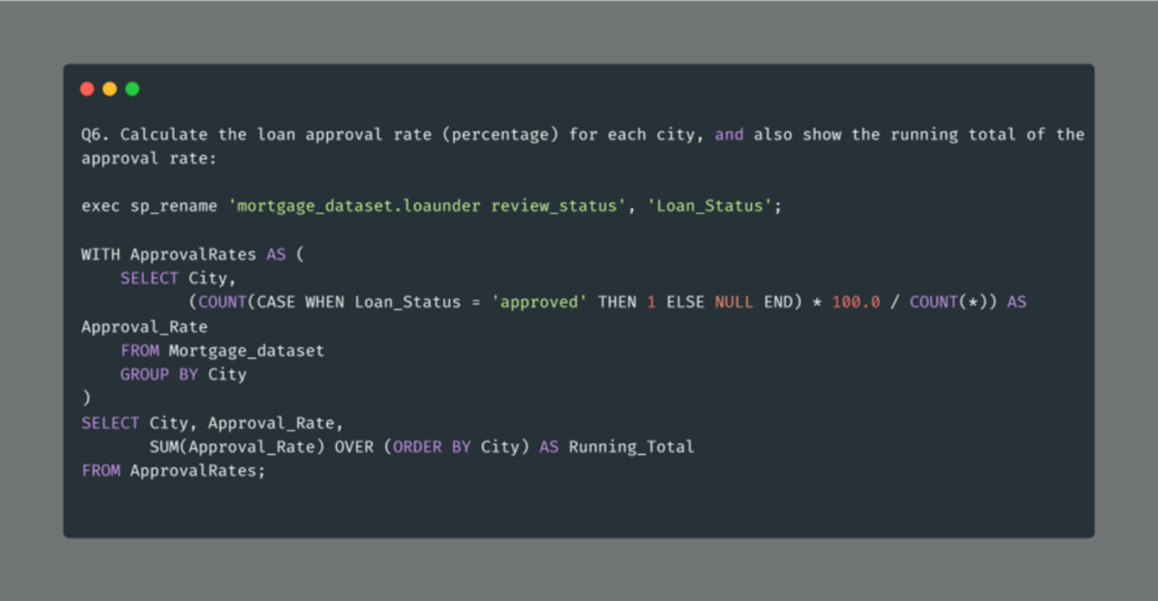
Understanding loan approval rates on a city-by-city basis is essential for evaluating the performance and trends in lending practices.

Slide 19
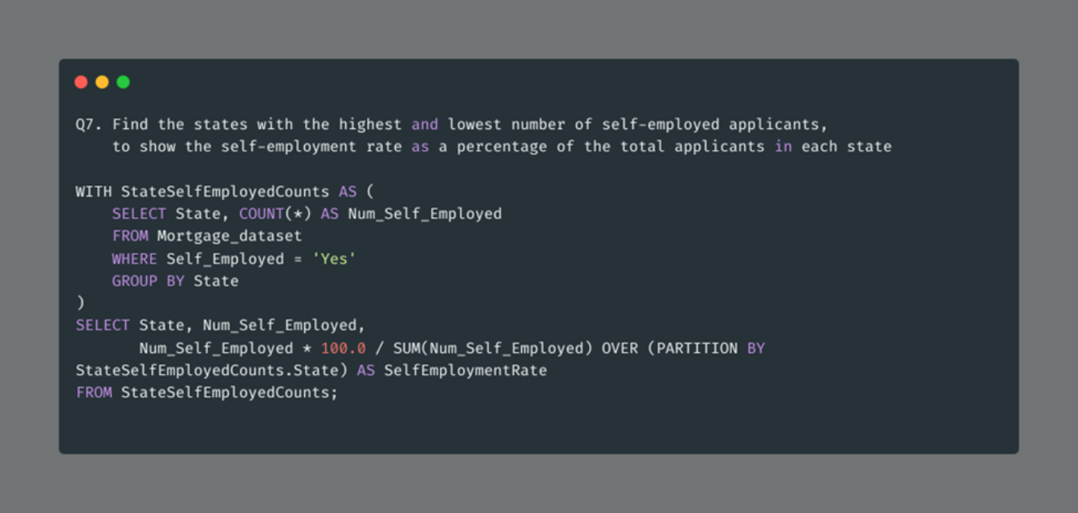
This SQL query efficiently addresses the need to identify states with varying levels of self-employment among mortgage applicants. By using a common table expression (CTE) named StateSelf-EmployedCounts, it first counts the number of self-employed applicants in each state, filtering data where the 'Self-employed' field is marked as 'Yes'. The resulting dataset contains state-wise self-employment counts.

Slide 20
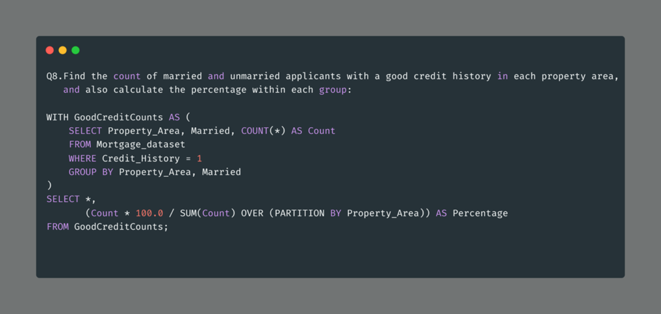
This query allows us to understand the distribution of applicants with good credit histories across different property areas while considering their marital status. The resulting data can be used to inform lending policies, marketing strategies, or other business decisions related to mortgage applications.

Slide 21
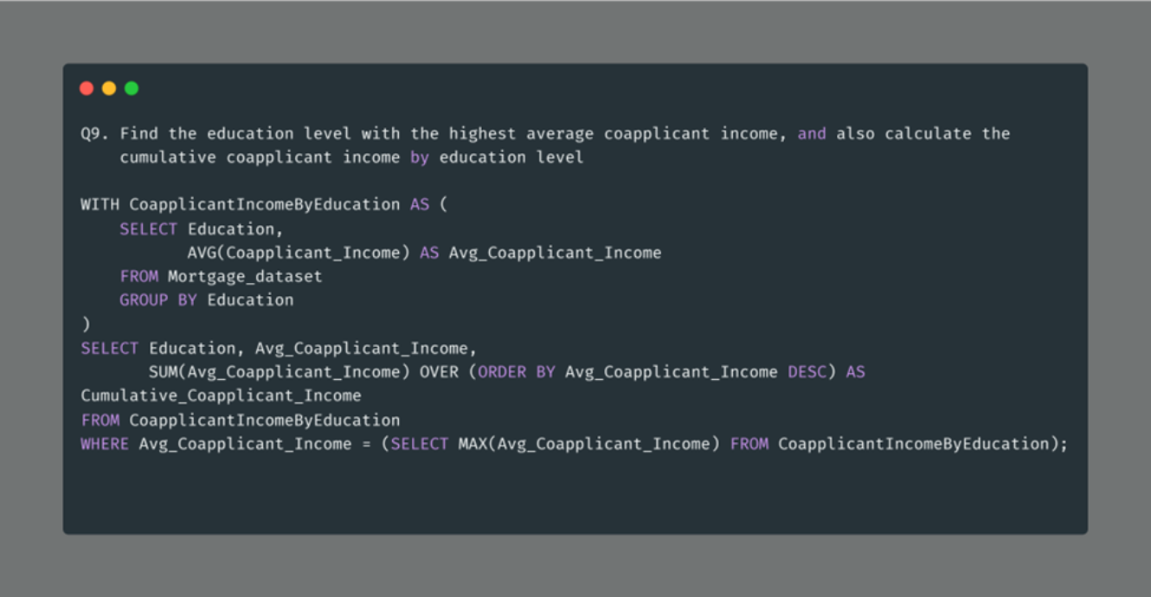
This SQL query provides valuable insights into the relationship between education levels and co-applicant income in the context of mortgage data analysis. It helps us identify the education level that, on average, has the highest co-applicant income and calculates the cumulative co-applicant income for all education levels.

Slide 22
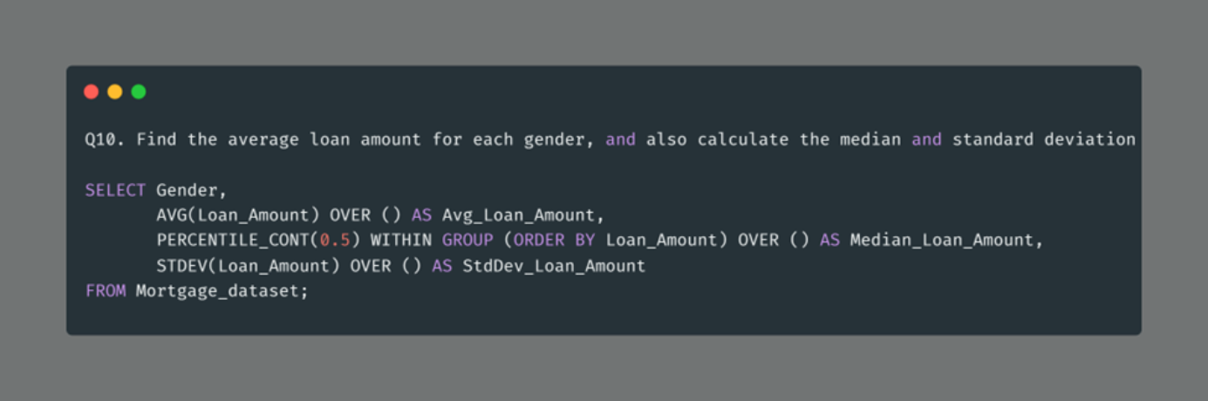
The SQL query efficiently calculates and presents key statistical measures for loan amounts in our mortgage dataset, stratified by gender. It offers valuable insights by providing the average loan amount, which indicates the typical borrowing amount for each gender, as well as the median loan amount, which represents the middle point in the distribution.

Slide 23
Data Visualization
1
Vision
To become a trusted leader in the mortgage industry by leveraging data insights and technology to simplify and enhance the home financing experience for borrowers and lenders.
2
Mission
Our mission is to empower borrowers with financial literacy, streamline mortgage processes for lenders, and promote financial stability within communities through innovative data-driven solutions.
3
Goal
Our goal is to provide a comprehensive platform that optimizes the mortgage application and approval process, reducing paperwork, improving transparency, and increasing access to affordable home financing.
4
Strategy
Our target customers include individuals seeking mortgages, lending institutions, real estate professionals, and regulatory bodies in the mortgage and housing sector. We aim to create value for both borrowers and lenders in the mortgage market.

Slide 24

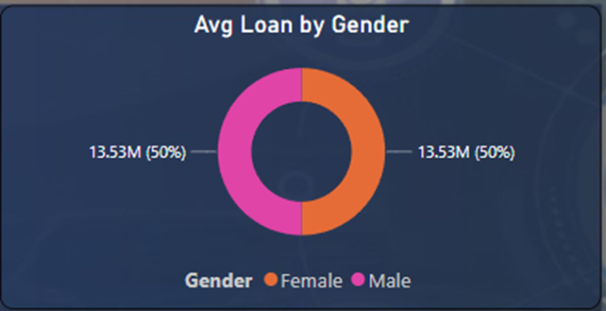
Avg Loan By Gender
"On average, there is an equitable distribution of loan amounts among male and female borrowers, with both genders requesting loans in similar amounts. This parity reflects our commitment to providing equal lending opportunities to all applicants, irrespective of their gender."
While the equitable distribution of loan amounts is a positive outcome, we should continue to monitor and improve our lending practices to ensure gender equality and prevent any unintended bias. Here are a few ways to further enhance our approach.

Slide 25

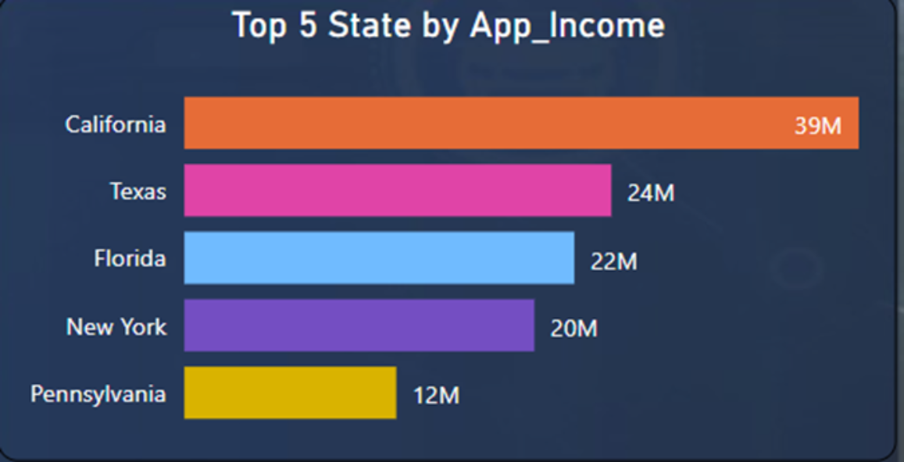
Top 5 State Applicant_Income
"According to our analysis, the top 5 states with the highest applicant incomes, with an average applicant income ranging from. Applicants from these states tend to have a comparatively higher income, which may be indicative of stronger financial stability."

Slide 26
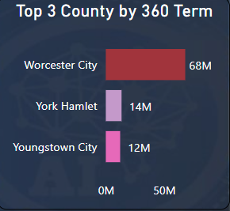
Top 3 County by 360 Term
"County Worcester City leads the way with the highest number of loans with a 360-month term. This suggests that many residents in County A prefer long-term mortgages.
County York Hamlet comes in second place for loans with a 360-month term. This could be due to various factors, such as lower interest rates in the area or a stable real estate market that encourages homeowners to commit to long-term loans."
"County Youngstown City takes the third spot for loans with a 360-month term. While it may have fewer such loans compared to the top two counties”

Slide 27

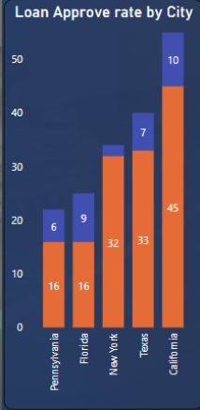
Loan Approve Rate by City
"Loan approval rates vary by city, with City California having the highest approval rate at 45 salaried applicant, while City Pennsylvania has a lower approval rate of 16 salaried applicant. These disparities may be due to factors such as income levels, credit scores, and employment opportunities in each city.".

Slide 28
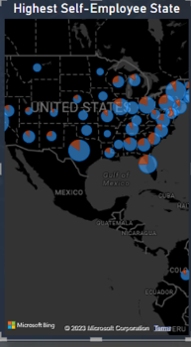
Highest Self-Employee State
"The Highest Self-Employee State in the U.S. where self-employment rates are notably high. Self-employed individuals in these states have taken the initiative to start their businesses and contribute to local economies. These states have a thriving entrepreneurial spirit, with a significant portion of the workforce working independently or as freelancers.

Slide 29
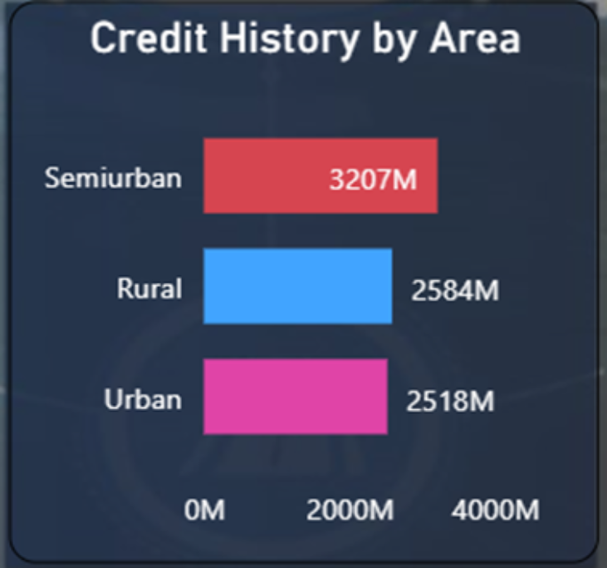
Credit History by Area
"Semiurban areas exhibit a commendable track record of credit history. Borrowers from these regions have consistently demonstrated responsible financial behavior, including timely repayment of loans and a low incidence of defaults."
"Rural areas show a mixed credit history, with some borrowers maintaining good credit, while others face challenges in meeting their financial obligations"
"Urban areas reflect a varied credit history, with a range of credit scores and financial behaviors. Borrowers in urban settings have diverse economic backgrounds and financial needs."
Loading...

Slide 30


EDA using Python
Python is crucial in a U.S. Mortgage Corporation's EDA project for its versatility in handling data manipulation and analysis, offering a rich ecosystem of libraries (e.g., Pandas, NumPy, Matplotlib) that streamline tasks, enhance visualization, and facilitate informed decision-making.

Slide 31
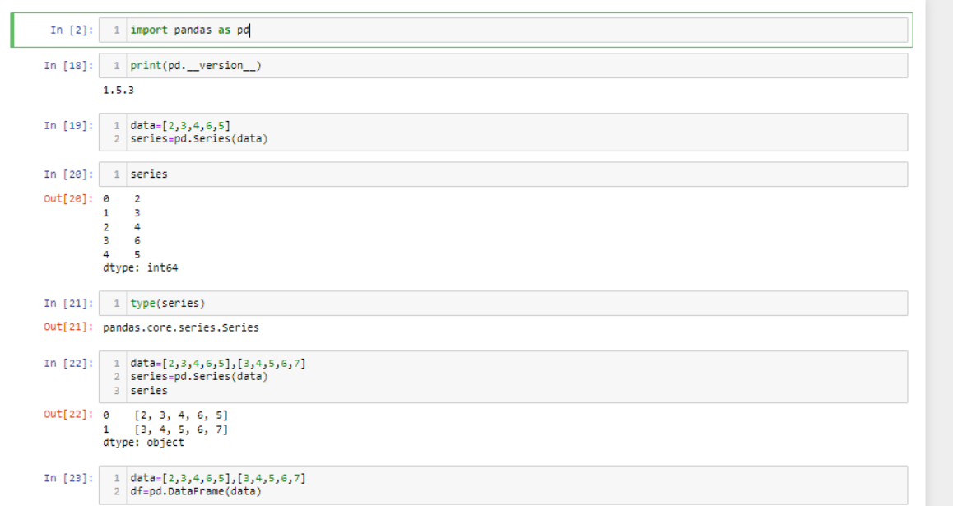
Import Pandas & DF
EDA involves analyzing and visualizing the dataset to gain insights, understand the underlying patterns, and make informed decisions about the subsequent steps in your analysis or modeling process

Slide 32

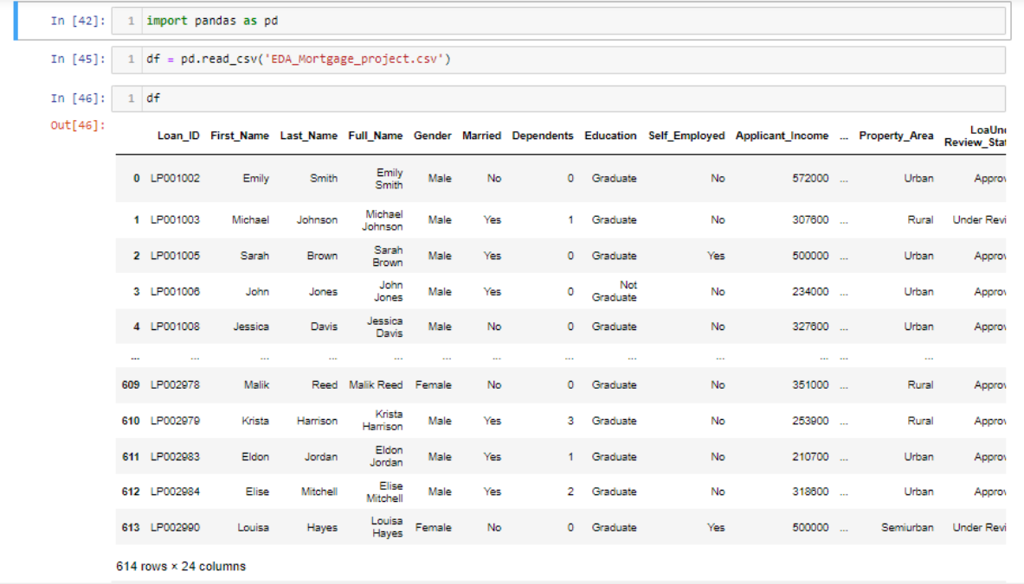
Importing csv file in Jupyter environment
In a Jupyter Notebook, you can import a CSV (Comma Separated Values) file using the pandas library, which is a powerful data manipulation and analysis library in Python

Slide 33

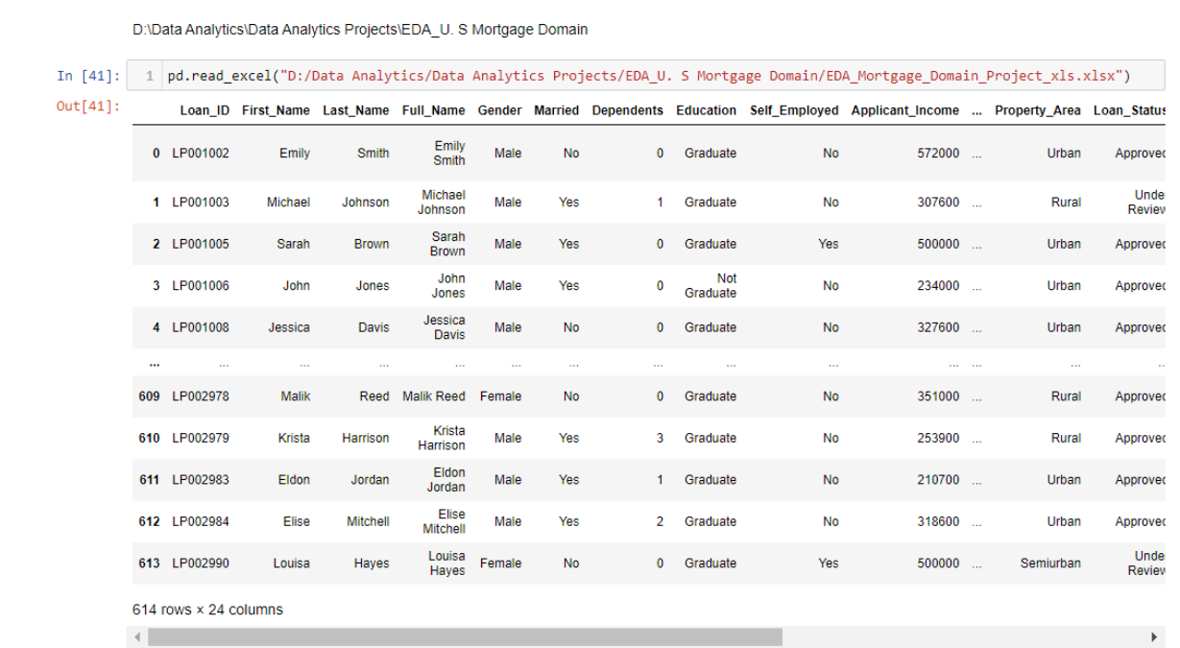
Importing 'xlsx' file in Jupyter environment
Importing an Excel file (.xlsx) in a Jupyter Notebook is similar to importing a CSV file. You can use the pandas library for this task.

Slide 34

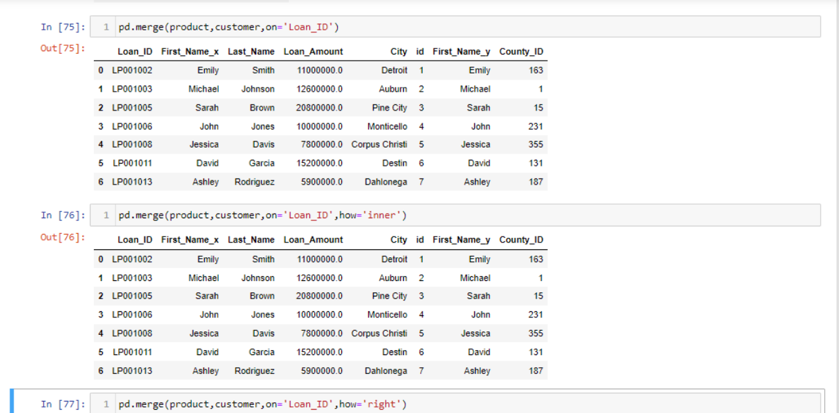
Using JOIN Concept in Pandas
In pandas, you can use the merge function to perform various types of joins between DataFrames, similar to SQL joins. The merge function allows you to combine two or more DataFrames based on a common column or index.

Slide 35
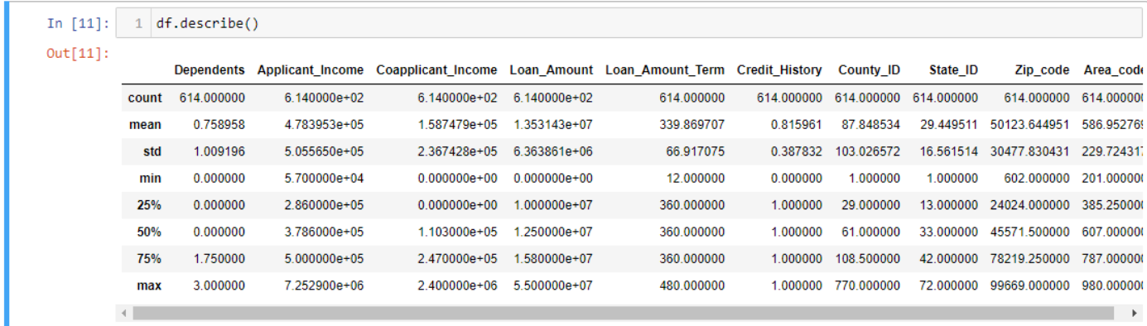
Describe Data Frame
In the context of programming with Python, specifically with the pandas library, a DataFrame is a two-dimensional, tabular data structure.

Slide 36

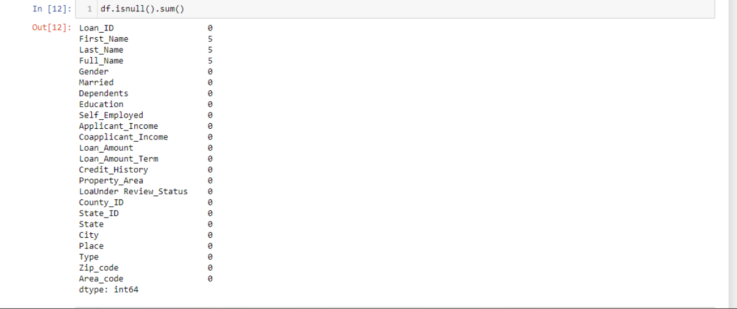
Fetching Null Values
To identify and fetch null (or missing) values in a pandas DataFrame, you can use the ISNULL() or NULL() method. These methods return a DataFrame of the same shape as the input, where each element is a Boolean value indicating whether the corresponding element in the original DataFrame is null.

Slide 37
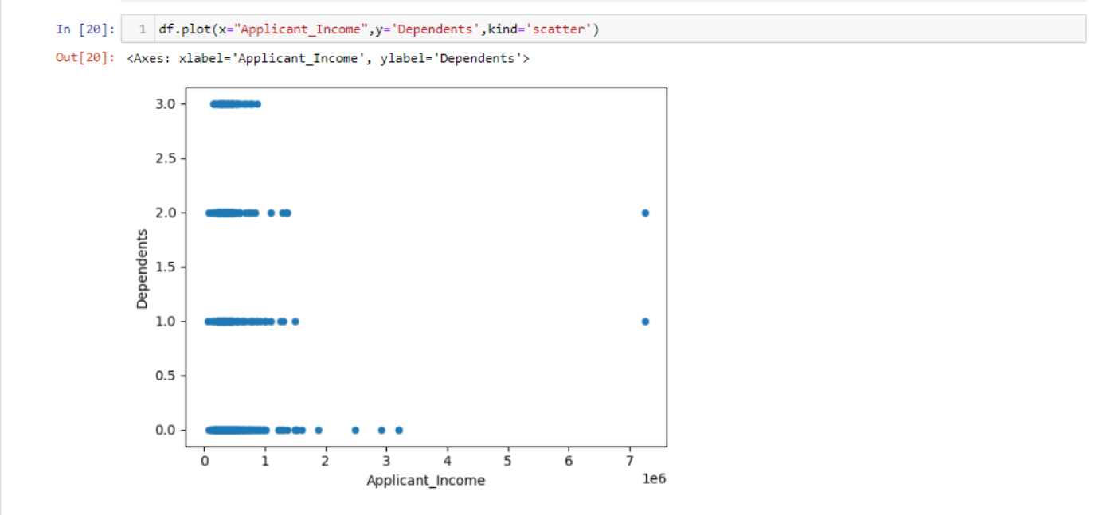
Using Matplotlib for Plot DF
Using the matplotlib libraries for basic plotting with pandas DataFrames.

Slide 38




Conclusions
Key Insights & Trends
Our EDA revealed significant trends, including a positive correlation between credit scores and loan approval rates, regional variations in loan amounts, and a rise in mortgage applications during certain months.
Implications for the Mortgage Industry
These insights offer valuable guidance to the mortgage industry. Lenders can tailor their strategies to specific regions and target customers with higher credit scores for increased approval rates.
Limitations & Future Research
While this analysis is insightful, it's important to acknowledge limitations like data availability and potential biases. Future research could delve into predictive modeling, customer segmentation, and assessing the impact of macroeconomic factors on mortgage trends.

Slide 39

Thank you for joining us on this journey! We appreciate your time and attention as we explore the fascinating world of mortgages, data analysis, and visualization.

